Slide 1
Home Credit Default Risk Analysis
Mentored By : Mohit SAHU
Submitted By: Samarth, Vikas Nehra, Rahul Rana, Nishchay Chauhan

Slide 2
Problem Definition
In this presentation, we will explore the risk of home credit default.
It is a major challenge for banks and other finance lending agencies to decide for which candidates to approve housing loans. The credit history is not always a sufficient tool for decisions, since it is possible that those borrowers with a long credit history can still default on the loan and some people with a good chance of loan repayment may simply not have a sufficiently long credit history.
The problem statement can be summarized as a binary classification problem where the inputs are various features describing the financial and behavioral history of the loan applicants, in order to predict whether the loan will be repaid or defaulted.

Slide 3
Dataset Description
The Home Credit Default Risk dataset is a comprehensive collection of data related to loan applications for home credit. The dataset includes various features such as client information, loan attributes, and previous credit history. It is designed to predict the likelihood of a client defaulting on their loan.
The Data is taken from Kaggle's competition which is available publicly. There are ~300K records and 122 columns with different data types such as 65 floating point numbers, 41 integer numbers (some are numerical categories), 16 Strings.
Some samples of the data field are: Gender, Education, Income, Housing type etc. Since the ML model can't inherently deal with text, the data must be converted to appropriate numbers. Any significant distortion/noise in the model must be removed as much as possible.

Slide 4
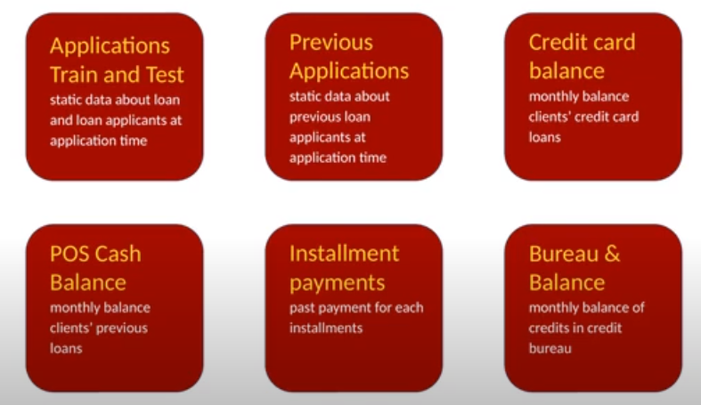

Slide 5
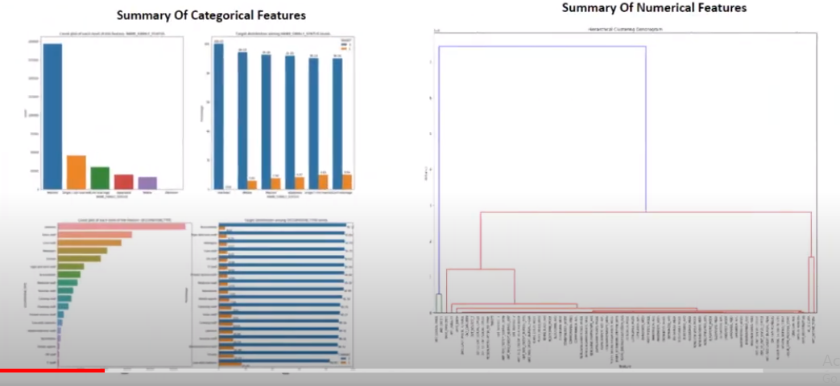

Slide 6
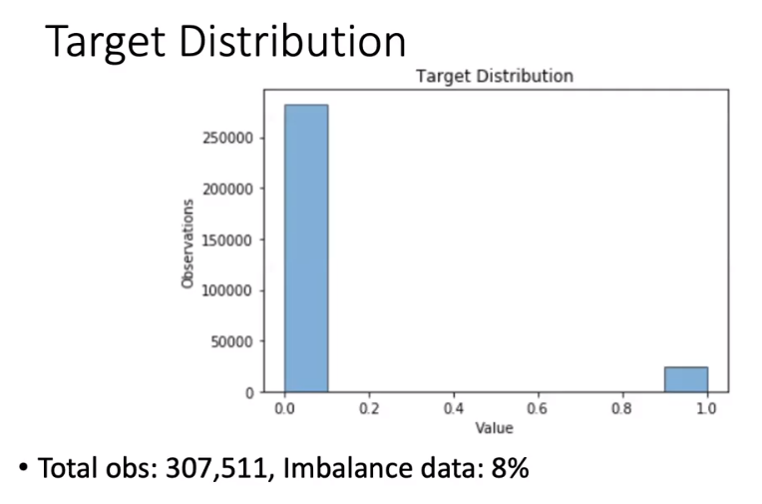
Here we observe an imbalanced data, which we will further deal through under-sampling method of balancing the data

Slide 7
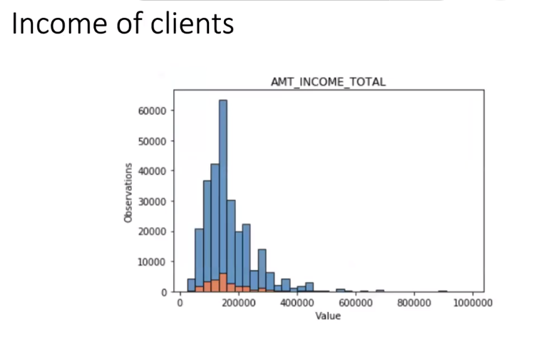
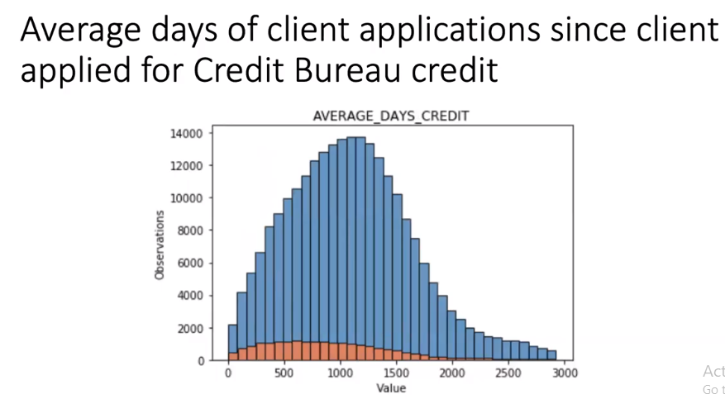

Slide 8
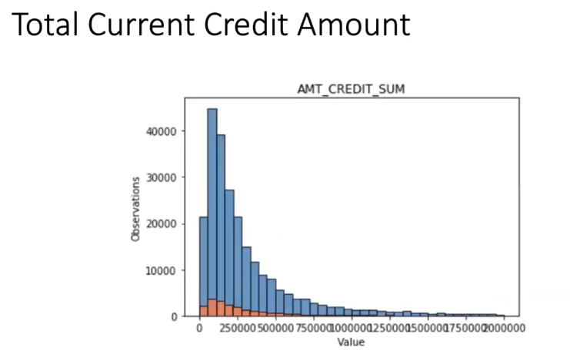

Slide 9
EDA :
Due to the huge data set and inherent noises, there are many
cleaning steps involved and listed as follows:
Converting string categorical columns into numerical through Label Encoding.
Converting string categorical columns into numerical and adding new columns to indicate the presence of categorical Variables.
One hot encoding-Replacing illogical outliers with empty values (NAN values)
Imputing empty cells with the median of the values. In some cases, imputation is approached with a certain grouping or using the mode in cases of categorical columns.
Dealing with a few anomalies like changing invalid entries into valid entries

Slide 10
FEATURE SELECTION
1. Feature Importance:
Feature importance in machine learning delves into the question: which features matter most when your model makes predictions? It's like figuring out the key ingredients in a delicious recipe - each feature contributes to the final outcome, but some play a more prominent role than others. After ascertaining the ‘more’ important features we went onto removing the features that were deemed less important by the algorithm.
Feature importance assigns a "score" to each feature, reflecting its impact on the model's predictions. A higher score indicates a stronger influence.

Slide 11
2. Recursive Feature Elimination:
Recursive Feature Elimination (RFE) is a feature selection technique that iteratively eliminates less important features to identify the most relevant subset for a machine learning model.
It attempts to meticulously, carefully, pruning features until only the most impactful ones remain.

Slide 12
Statistical Test (CHI-SQUARE):
The Chi-square test is a statistical method used to determine if there is a significant association between two categorical variables. It is a non-parametric test, meaning it makes no assumptions about the distribution of the data. The test is applicable when the variables are categorical and the data can be presented in a contingency table.
Null Hypothesis (H0) and Alternative Hypothesis (H1):H0: There is no significant association between the variables.H1: There is a significant association between the variables.
Compare the calculated Chi-square statistic to the critical value from the Chi-square distribution or obtain the p-value. Make a decision based on the significance level of .05
The following 13 categorical features were suggested to be insignificant:
'FLAG_MOBIL', 'FLAG_CONT_MOBILE', 'FLAG_EMAIL', 'LIVE_REGION_NOT_WORK_REGION', 'FLAG_DOCUMENT_4', 'FLAG_DOCUMENT_5', 'FLAG_DOCUMENT_7', 'FLAG_DOCUMENT_10', 'FLAG_DOCUMENT_12', 'FLAG_DOCUMENT_17', 'FLAG_DOCUMENT_19', 'FLAG_DOCUMENT_20', 'FLAG_DOCUMENT_21', 'AMT_REQ_CREDIT_BUREAU_HOUR', 'AMT_REQ_CREDIT_BUREAU_DAY', 'AMT_REQ_CREDIT_BUREAU_WEEK‘.

Slide 13
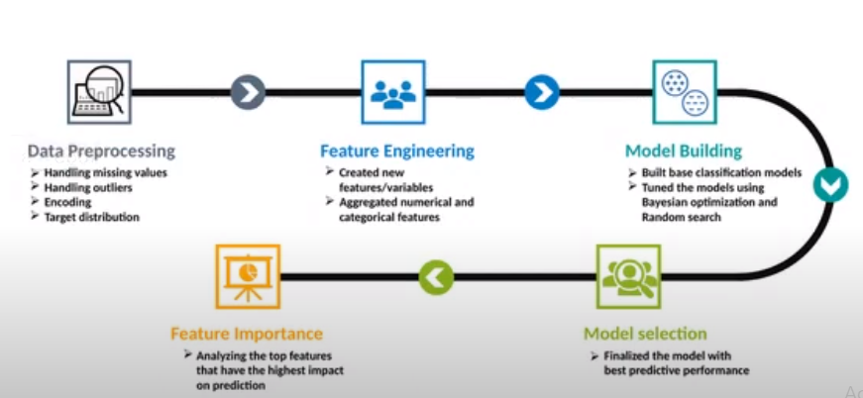
Standard Model Building Process

Slide 14
MODEL SELECTION

Slide 15
ML Models
Name of The Model | Accuracy | Precision | Recall | F1
1. Logistic Regression | 0.777794 | 0.227329 | 0.585314 | 0.327472
2. Logistic Regression (New Base) | 0.777355 | 0.218301 | 0.586549 | 0.318182
3. Decision Tree | 0.675260 | 0.368691 | 0.334575 | 0.350805
4. Bagging | 0.762756 | 0.211325 | 0.503667 | 0.297731
5. AdaBoost | 0.781065 | 0.236767 | 0.601668 | 0.339812
6. Random Forest | 0.777452 | 0.162290 | 0.624803 | 0.257655

Slide 16
Thank You!
s

